Slide 1
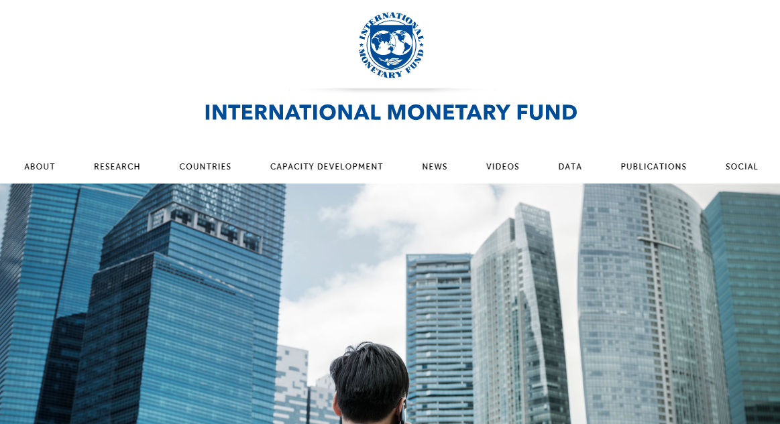

Slide 2
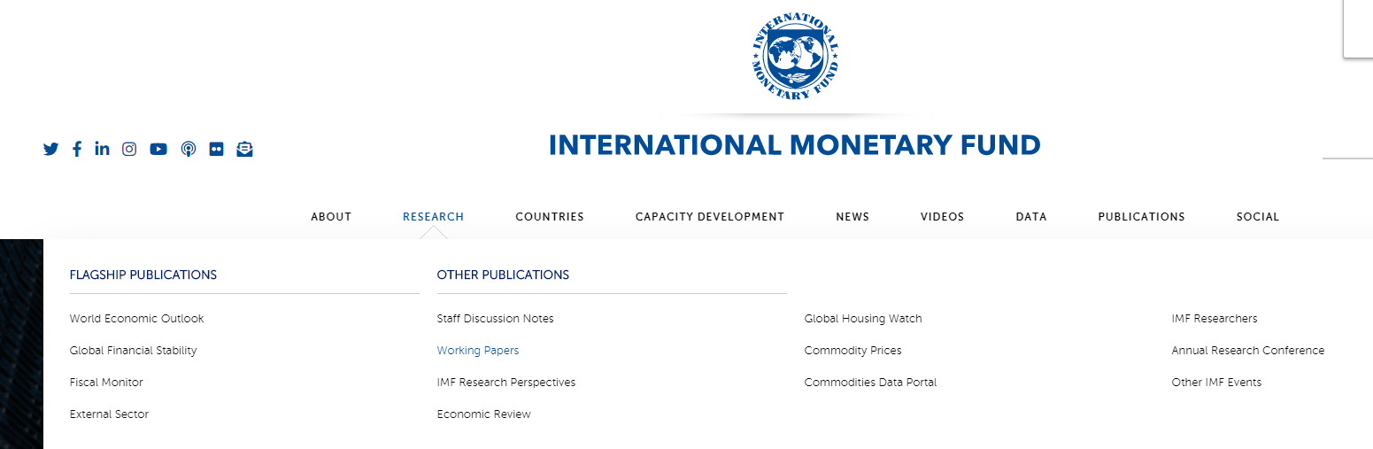

Slide 3
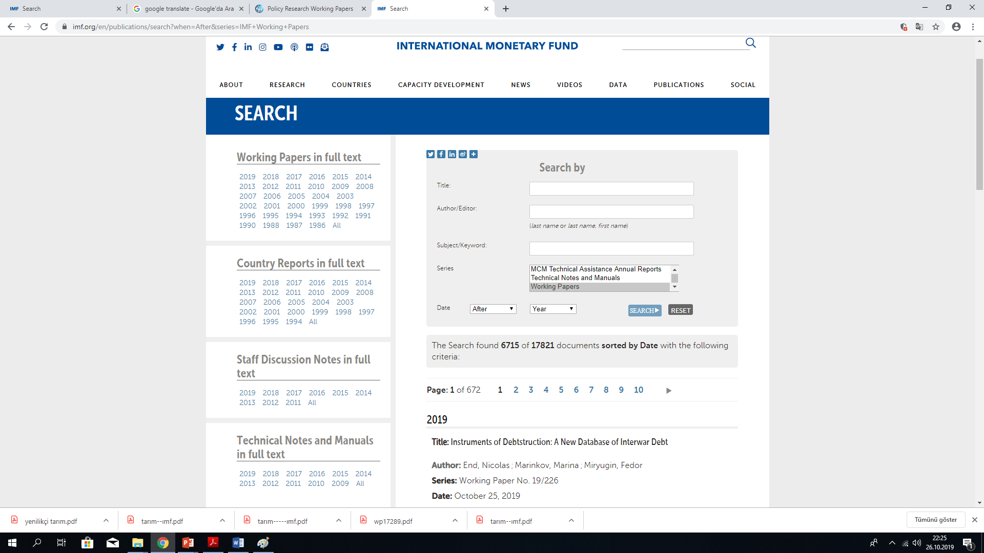

Slide 4
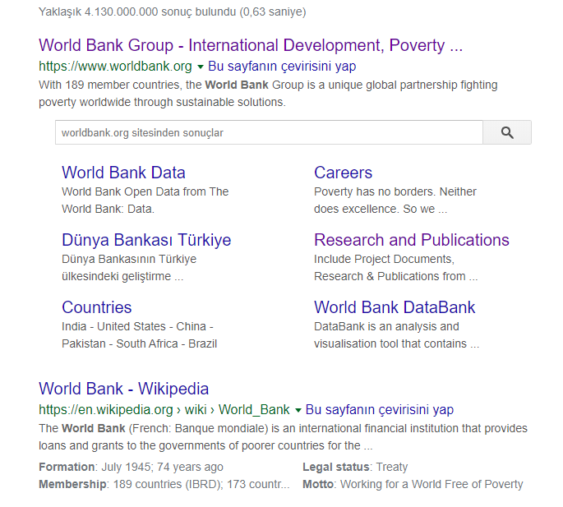

Slide 5
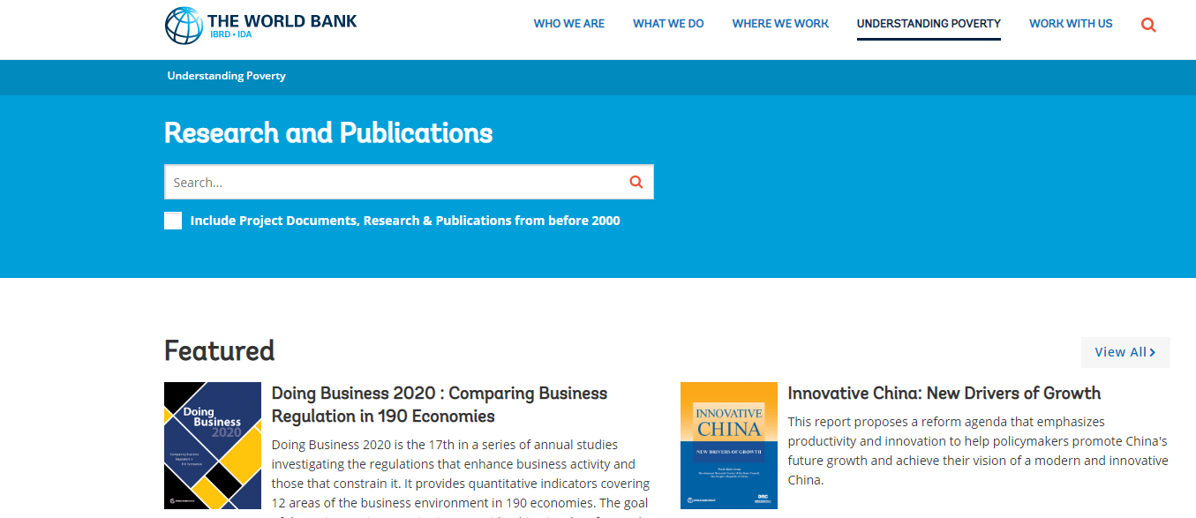

Slide 6
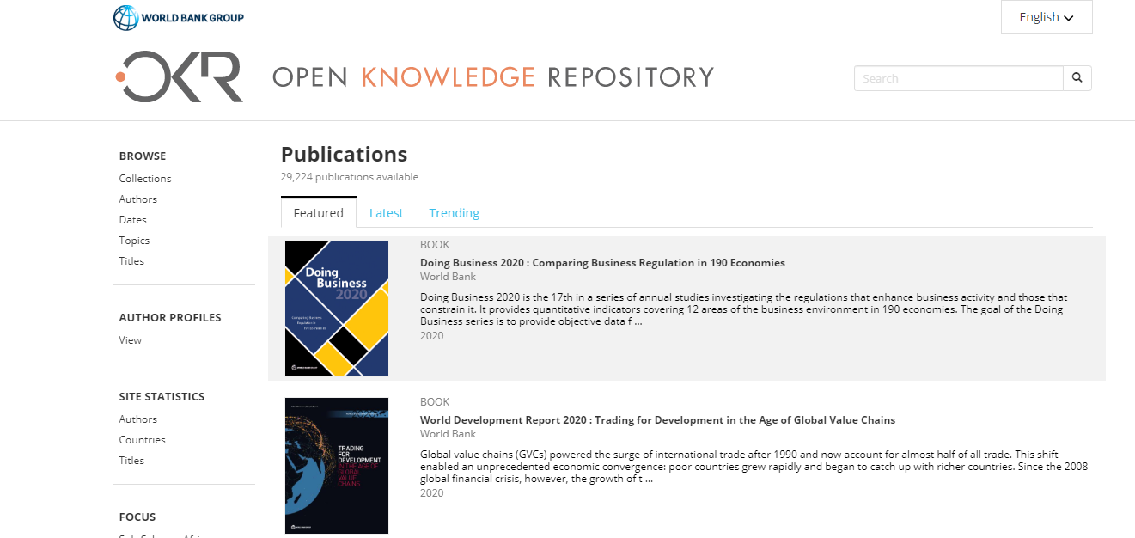

Slide 7
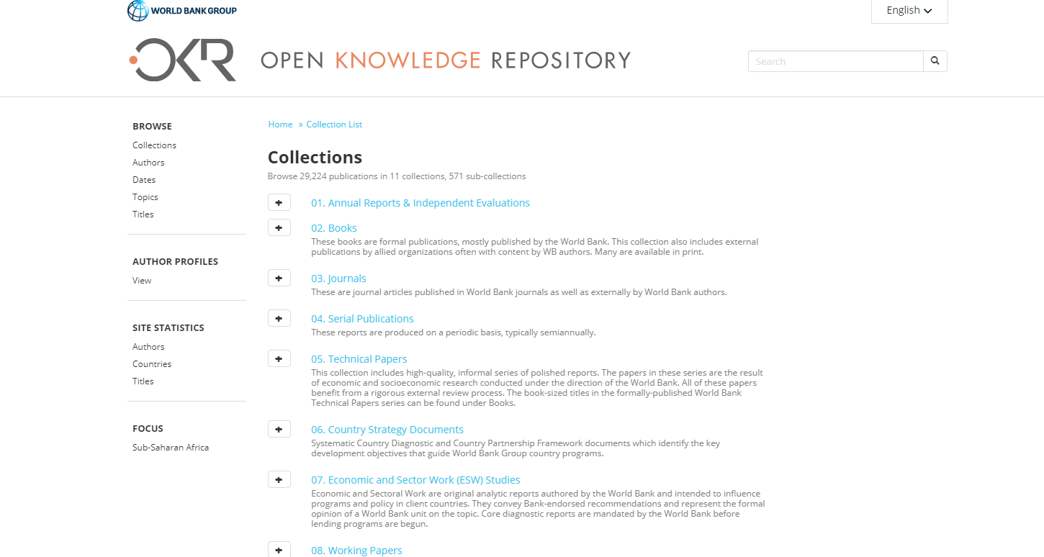

Slide 8
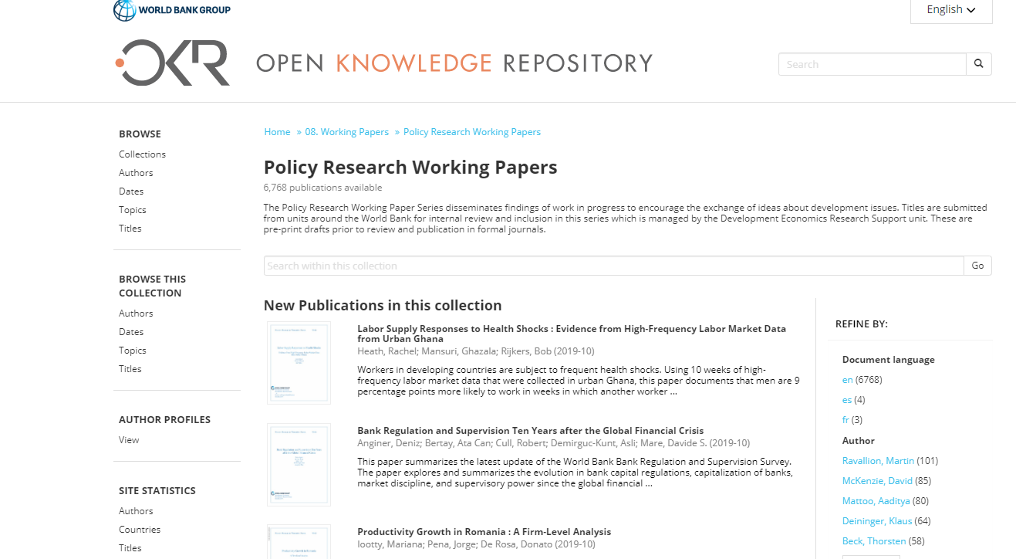

Slide 9
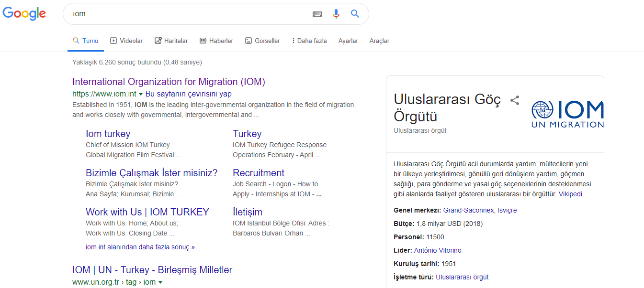

Slide 10
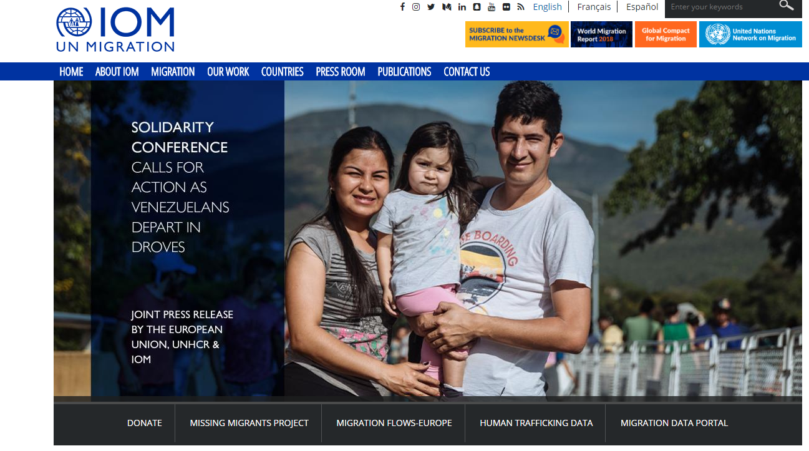

Slide 11
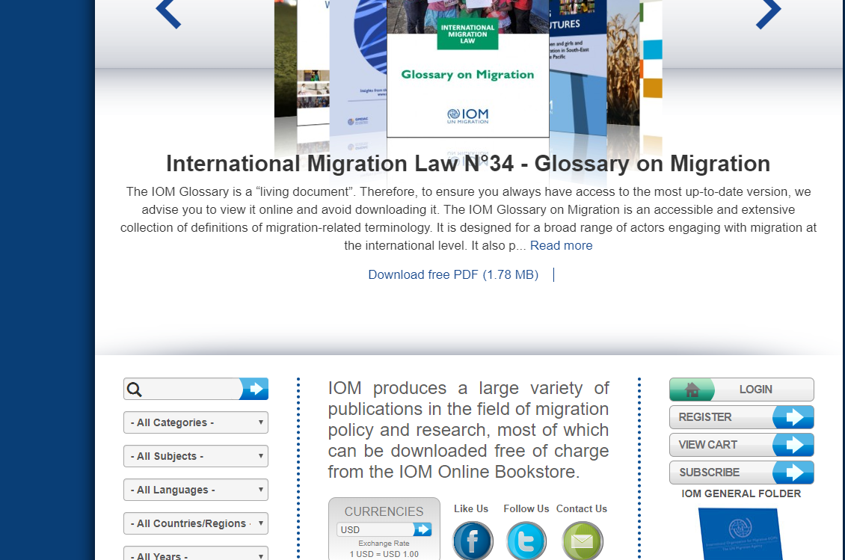

Slide 12
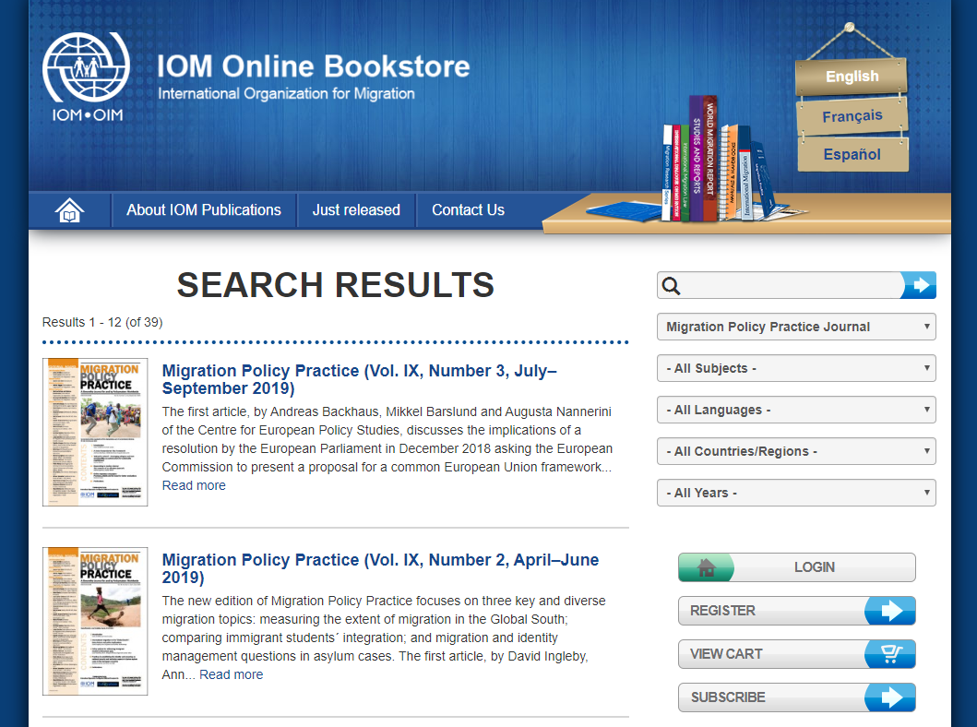

Slide 13
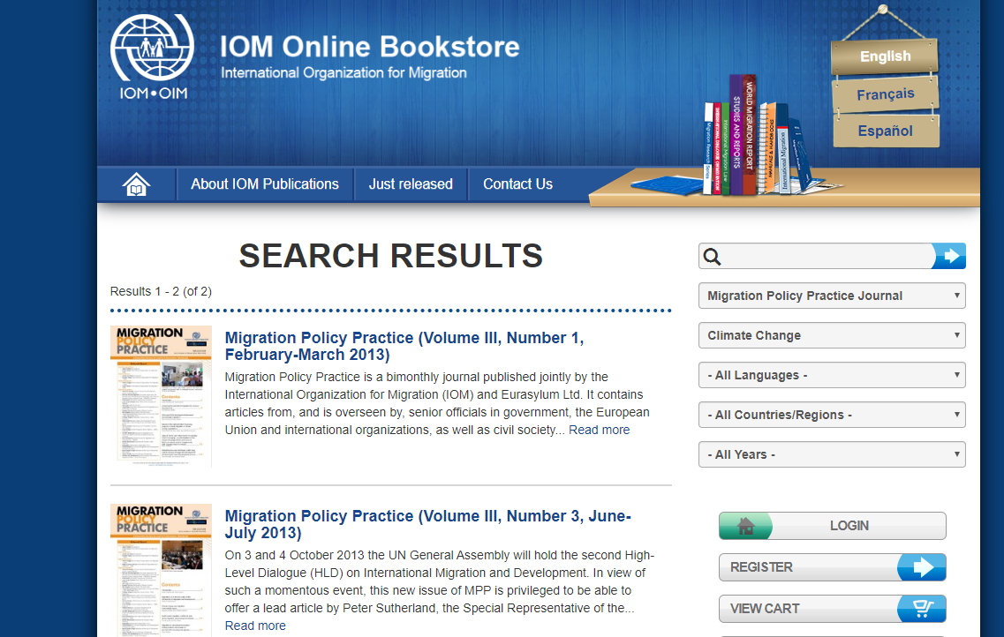

Slide 14
KONU | BAŞLIK | YAZARLAR | YIL | TÜR
climate change | Policy Trade-Offs in Building Resilience to Natural Disasters: The Case of St. Lucia | Cantelmo, Alessandro ; Bonato, Leo ; Melina, Giovanni ; Salinas, Gonzalo | 2019 | IMF working paper
 | Importing Inputs for Climate Change Mitigation: The Case of Agricultural Productivity | Garcia-Verdu, Rodrigo ; Meyer-Cirkel, Alexis ; Sasahara, Akira ; Weisfeld, | 2019 | IMF working paper
 | Climate Disaster Risks – Empirics and a Multi-Phase Dynamic Model | Mittnik, Stefan ; Semmler, Willi ; Alexander Haider | 2019 | IMF working paper
 | Optimal Control of a Global Model of Climate Change with Adaptation and Mitigation | Atolia, Manoj ; Loungani, Prakash ; Maurer, Helmut ; Semmler, Willi | 2018 | IMF working paper
 | Macro-Fiscal Implications of Climate Change: The Case of Djibouti | Kireyev, P Alexei | 2018 | IMF working paper
 | Gone with the Wind : Estimating Hurricane and Climate Change Costs in the Caribbean | Acevedo Mejia, Sebastian | 2016 | IMF working paper

Slide 15
KONU | BAŞLIK | YAZARLAR | YIL | TÜR
international trade agreements/ trade wars | Trade Wars and Trade Deals: Estimated Effects using a Multi-Sector Model | Caceres, Carlos ; Cerdeiro, A. Diego ; Mano, Rui | 2019 | IMF working paper
 | The African Continental Free Trade Agreement: Welfare Gains Estimates from a General Equilibrium Model | Abrego, Lisandro ; Amado, Maria Alejandra ; | 2019 | IMF working paper
 | Understanding Export Diversification: Key Drivers and Policy Implications | Giri, Rahul ; Quayyum, N Saad ; Rujun Yin | 2019 | IMF working paper
 | A Multidimensional Approach to Trade Policy Indicators | Cerdeiro, A. Diego ; Nam, J. Rachel | 2018 | IMF working paper
 | The Impact of Trade Agreements : New Approach, New Insights | Swarnali Ahmed Hannan | 2016 | IMF working paper
 | Estimating the Effects of the Trans-Pacific Partnership (TPP) on Latin America and the Caribbean (LAC) | Cerdeiro, A. Diego | 2016 | IMF working paper
 | Value of WTO Trade Agreements in a New Keynesian Model | Ganelli, Giovanni ; Tervala, Juha | 2015 | IMF working paper

Slide 16
KONU | BAŞLIK | YAZARLAR | YIL | TÜR
energy | Global Fossil Fuel Subsidies Remain Large: An Update Based on Country-Level Estimates | Coady, David ; Parry, Ian ; Le, Nghia-Piotr ; Shang, Baoping | 2019 | IMF working paper
 | Export Competitiveness - Fuel Price Nexus in Developing Countries: Real or False Concern? | Kpodar, R Kangni ; Fabrizio, Stefania ; Eklou, M. Kodjovi | 2019 | IMF working paper
 | Oil Prices and GCC Stock Markets: New Evidence from Smooth Transition Models | Ben Cheikh, Nidhaleddine ; Ben Naceur, Sami ; Kanaan, Oussama ; Rault, Christophe | 2018 | IMF working paper
 | The Long-Run Decoupling of Emissions and Output: Evidence from the Largest Emitters | Cohen, Gail ; Jalles, João Tovar ; Loungani, Prakash ; Marto, Ricardo | 2018 | IMF working paper
 | Canada’s Carbon Price Floor | Parry, W.H. Ian ; Mylonas, Victor | 2018 | IMF working paper
 | Oil Prices and Inflation Dynamics: Evidence from Advanced and Developing Economies | Choi, Sangyup ; Furceri, Davide ; Loungani, Prakash ; Mishra, Saurabh ;Poplawski-Ribeiro, | 2017 | IMF working paper

Slide 17
KONU | BAŞLIK | YAZARLAR | YIL | TÜR
Migration | Stranded! How Rising Inequality Suppressed US Migration and Hurt Those Left Behind | Bayoumi, Tamim ; Barkema, Jelle | 2019 | IMF working paper
 | Regional Labor Mobility in Spain | Liu, Lucy Qian | 2018 | IMF w. paper
 | The Labor Market Integration of Migrants in Europe: New Evidence from Micro Data | Ho, Giang ; Turk-Ariss, Rima | 2018 | IMF working paper
 | Storm Clouds Ahead?Migration and Labor Force Participation Rates in Europe | Hilgenstock, Benjamin ; Koczan, Zsoka | 2018 | IMF working paper
 | How Do Migration and Remittances Affect Inequality? A Case Study of Mexico | Koczan, Zsoka ; Loyola, Franz | 2018 | IMF working paper
 | Migration and Remittances in Latin America and the Caribbean : Engines of Growth and Macroeconomic Stabilizers? | Beaton, Kimberly ; Cerovic, Svetlana ; Galdamez, Misael ; | 2017 | IMF working paper
 | Caribbean Economic growth Economic Stabilization Emigration and immigration Latin America Remittances | Snudden, Stephen | 2017 | IMF working paper
 | Migration and jobs Issues for the 21st Century | Luc Christiaensen Alvaro Gonzalez, David Robalino | 2019 | P.R. Working Paper (W B)
 | Youth Labor Migration in Nepal | Bossavie, Laurent Denisova, Anastasiya | 2018 | P.R. Working Paper (W B)
 | Internal Borders and Migration in India | Kone, Zovanga L., Liu, Maggie Y. Mattoo, Aaditya, Ozden, C. | 2018 | P.R. Working Paper (W B)
 | Migration in Vietnam : New Evidence from Recent Surveys | Coxhead, Ian Cuong, Nguyen Viet Vu, Linh Hoang | 2015 | P.R. Working Paper (W B)

Slide 18
Migration, Environment and Climate Change | Marshallese perspectives on migration in the context of climate change | Kees van der Geest Maxine Burkett Juno Fitzpatrick Mark Stege Brittany Wheeler | 2019 | IOM PolicySeries Brief
 | IOM's Engagement in Migration Environment and Climate Change | Dina Ionesco | 2018 | IOM Working Paper Series
 | Fatal Journeys Volume 4: Missing Migrant Children |  |  | IOM Working Paper Series
 | New Evidence on Yemeni Return Migrants from the Kingdom of Saudi Arabia | Michele Bruni | 2018 | IOM Working Paper Series
 | The migration, environment and climate change nexus in Ghana | James W. Richmond, Bard College, Annandale | 2017 | IOM Working Paper Series
 | How can migration support adaptation? Different options to test the migration–adaptation nexus | François Gemenne1 and Julia Blocher2 | 2016 | IOM Working Paper Series
 | Migration, Environment and Climate Change in Kenya | Dulo Nyaoro | 2013 | IOM Working Paper Series

Slide 19
behavioral finance | A Behavioral Approach to Financial Supervision, Regulation, and Central Banking | Ashraf Khan | August , 2018 | IMF working paper
 | Media Sentiment and International Asset Prices | Samuel P. Fraiberger ; Do Lee ; Damien Puy | December 10, 2018 | IMF working paper
 | Lending Standards and Output Growth | Divya Kirti | January 26, 2018 | IMF working paper
 | The Use of Financial Incentives to Prevent Undesirable Behaviors | Walque, Damien | 2018 | Policy Research Working Paper (WORLD BANK)
 | Does Financial Education Impact Financial Literacy and Financial Behavior, and If So, When? | “Kaiser, Tim; Menkhoff, Lukas | 2017 | Policy Research Working Paper (WORLD BANK)
Agricultural Productivity/ İnnovative agriculture | Crop Selection and International Differences in Aggregate Agricultural Productivity | Jorge Alvarez ; Claudia Berg | August 2019 | IMF working paper
 | Macroeconomic Gains from Reforming the Agri-Food Sector: The Case of France | Nicoletta Batini | February 26, 2019 | IMF working paper

Slide 20
Agricultural Productivity İnnovative agriculture | The Globalization of Farmland: Theory and Empirical Evidence | Rabah Arezki ; Christian Bogman Harris Selod | June 22, 2018 | IMF working paper
 | The Long-Run Decoupling of Emissions and Output: Evidence from the Largest Emitters | Gail Cohen ; João Tovar Jalles ; …. | March 13, 2018 | IMF working paper
 | Structural Transformation and the Agricultural Wage Gap | Jorge Alvarez | December 22, 2017 | IMF working paper
 | Structural Reforms and Productivity Growth in Emerging Market and Developing Economies | Era Dabla-Norris ; Giang Ho ; Annette J | February 9, 2016 | IMF working paper
 | Innovative Agricultural SME Finance Models | World Bank Group. 2019 |  | (WORLD BANK)
 | Pakistan Development Update, June 2019 : Weathering the Storm - Restoring Macroeconomic Stability | World Bank Group. 2017 |  | (WORLD BANK)
 | Innovations for Scaling Green Sectors | World Bank Group. 2017 |  | (WORLD BANK)

